Slide 1
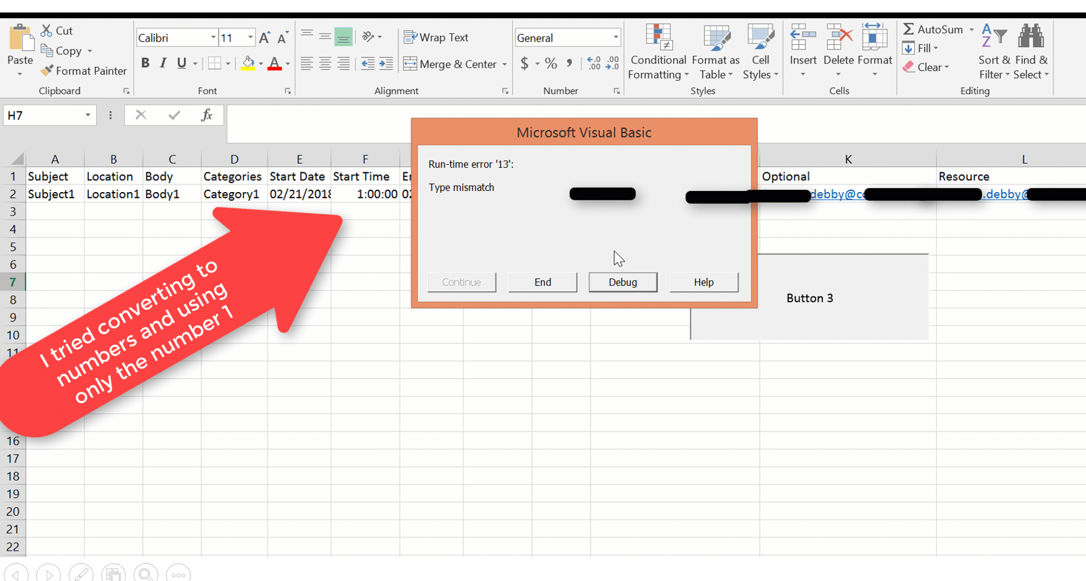
Error when running the macro

Slide 2
