Slide 1
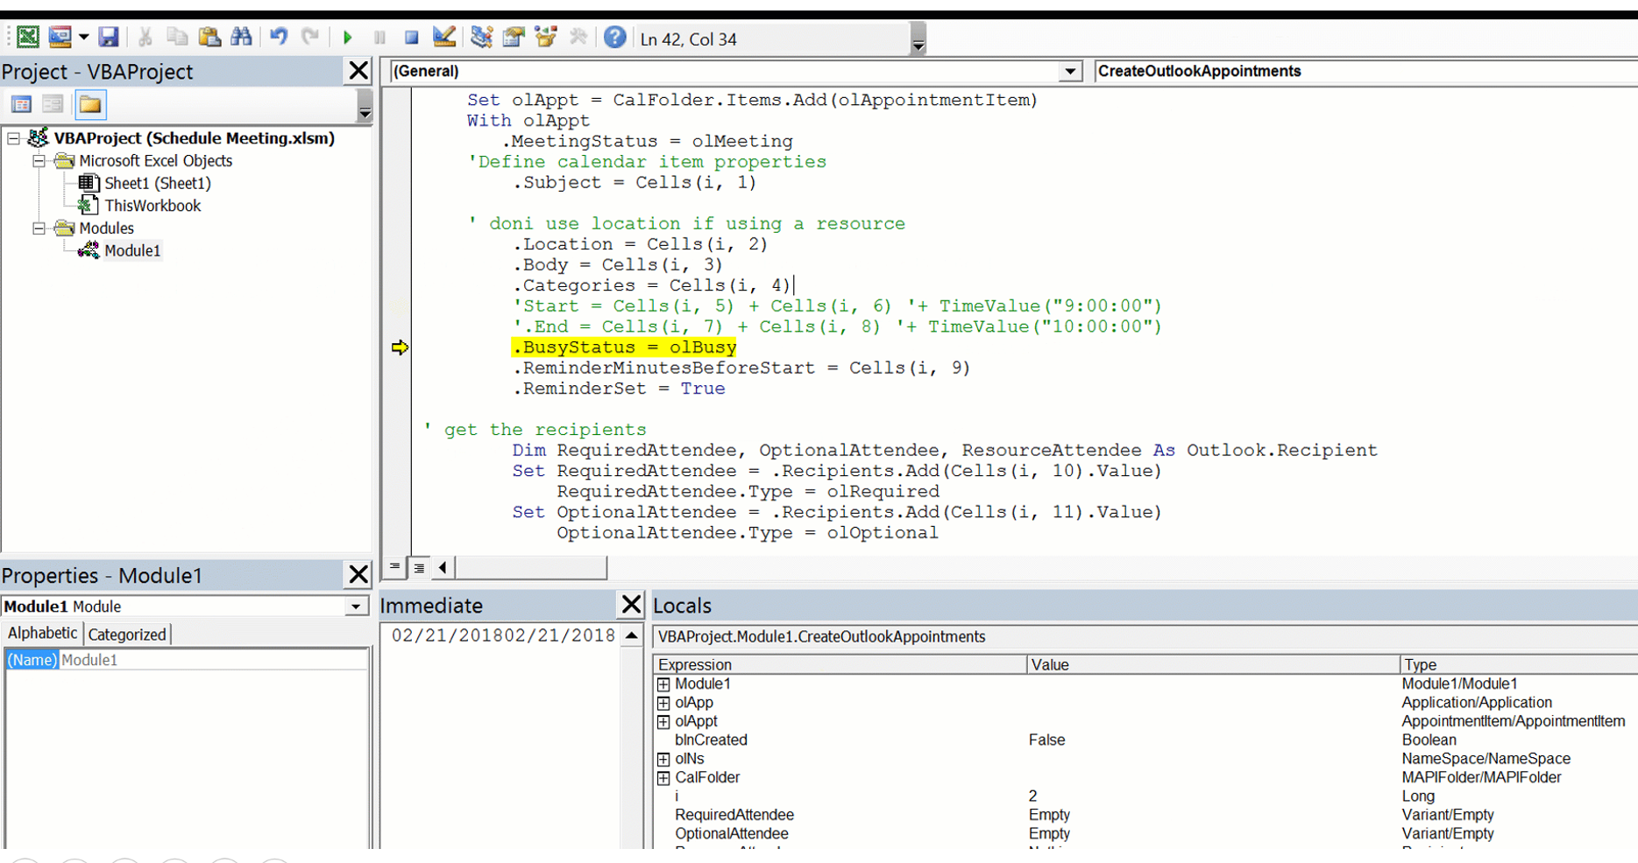
I removed the debug line and converted the start and end times to text

Slide 2
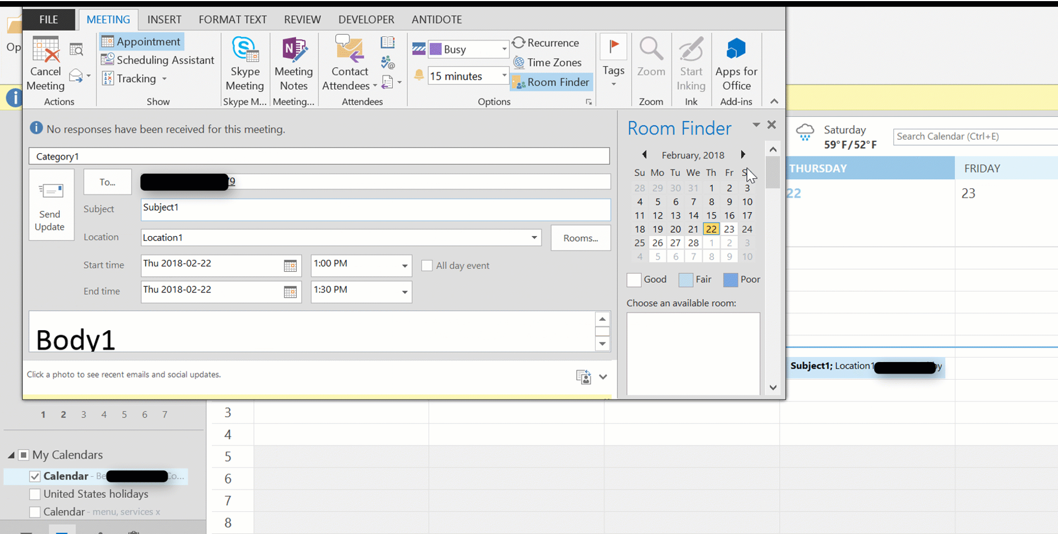
When I conver the lines to text the macro works, however I cannot assigne a time to the meeting

